Slide 1
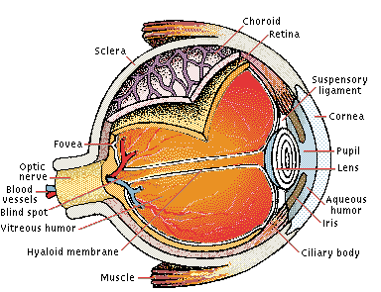
Human Eye
(Picture from Microsoft Encarta 2000)

Slide 2
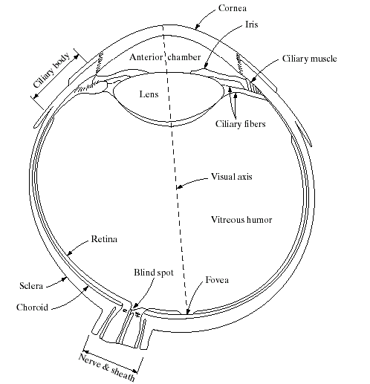
Human Eye
(Images from Rafael C. Gonzalez and Richard E.
Wood, Digital Image Processing, 2nd Edition.

Slide 3
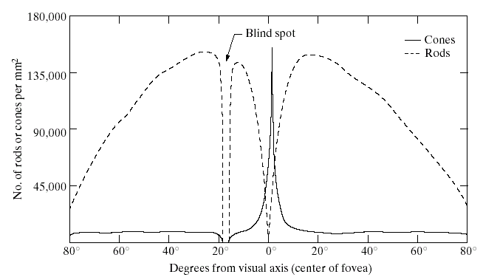
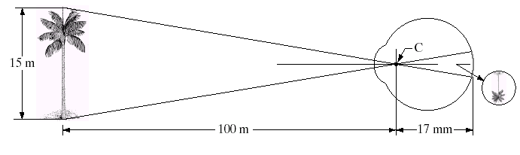
Receptors
Receptor’s Distribution
About 6-7 millions cones for bright light vision called photopic
Density of cones is about 150,000 elements/mm².
Cones involve in color vision.
Cones are concentrated in fovea about 1.5x1.5 mm².
About 75-150 millions rods for dim light vision called scotopic
Rods are sensitive to low level of light and are not involved color vision.
(Images from Rafael C. Gonzalez and Richard E.
Wood, Digital Image Processing, 2nd Edition.

Slide 4
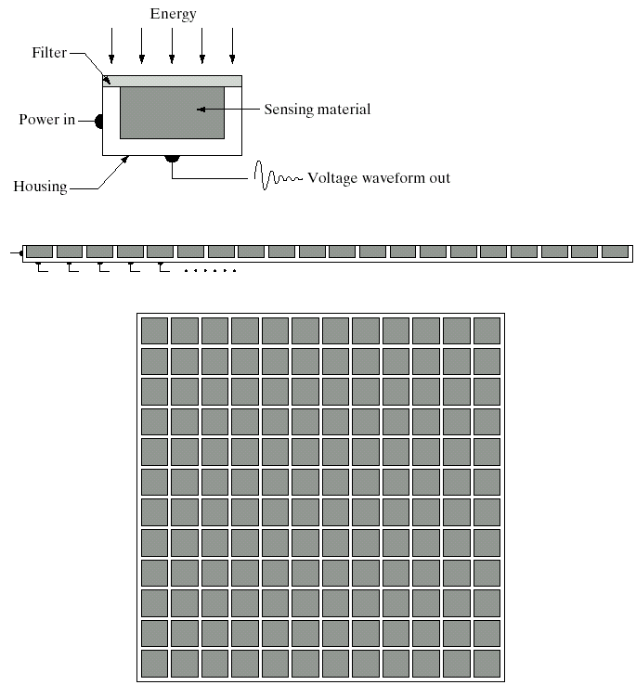
Image Sensors
Single sensor
Line sensor
Array sensor
(Images from Rafael C. Gonzalez and Richard E.
Wood, Digital Image Processing, 2nd Edition.

Slide 5
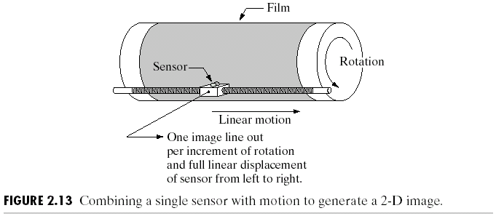
Image Sensors : Single Sensor
(Images from Rafael C. Gonzalez and Richard E.
Wood, Digital Image Processing, 2nd Edition.

Slide 6
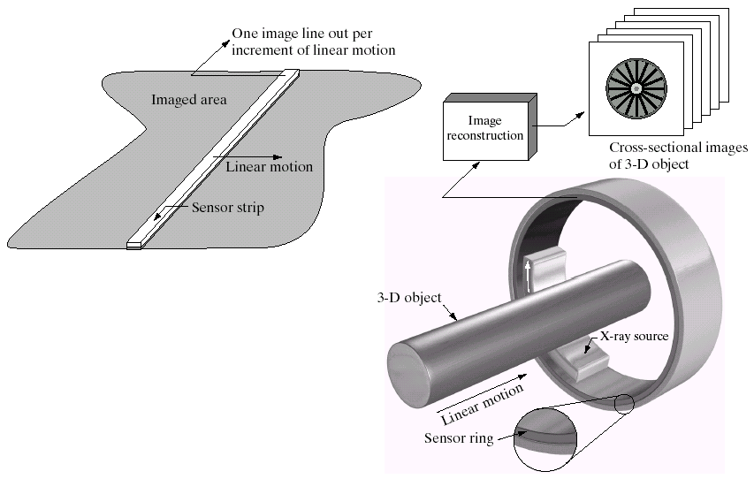

Image Sensors : Line Sensor
Fingerprint sweep sensor
Computerized Axial Tomography
(Images from Rafael C. Gonzalez and Richard E.
Wood, Digital Image Processing, 2nd Edition.

Slide 7
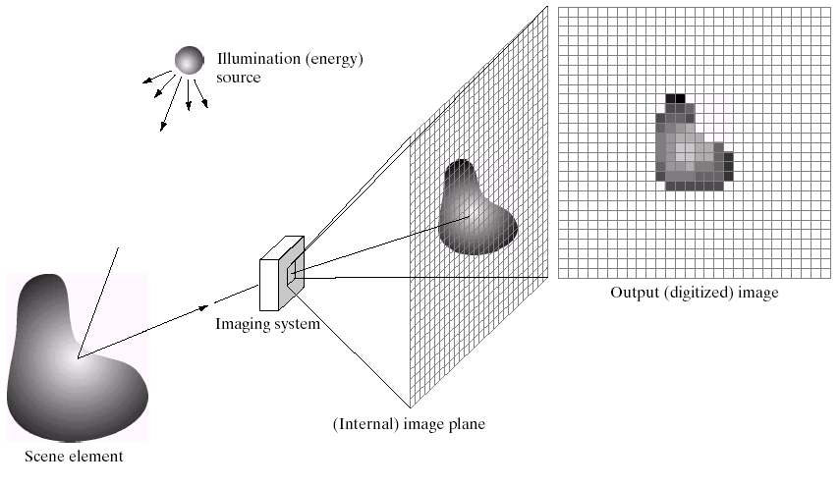
Image Acquisition: CCD Array
(Images from Rafael C. Gonzalez and Richard E.
Wood, Digital Image Processing, 2nd Edition.

Slide 8
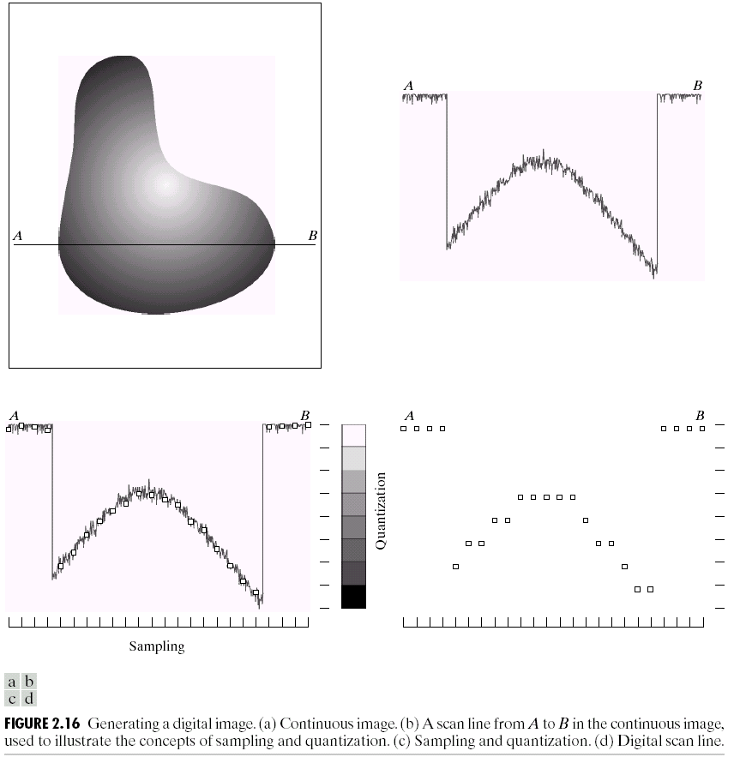
Image Sampling and Quantization
(Images from Rafael C. Gonzalez and Richard E.
Wood, Digital Image Processing, 2nd Edition.

Slide 9
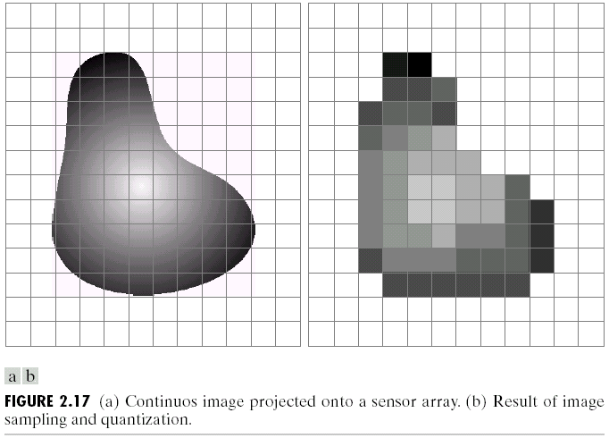
Image Sampling and Quantization
Spatial resolution
Intensity resolution
(Images from Rafael C. Gonzalez and Richard E.
Wood, Digital Image Processing, 2nd Edition.

Slide 10
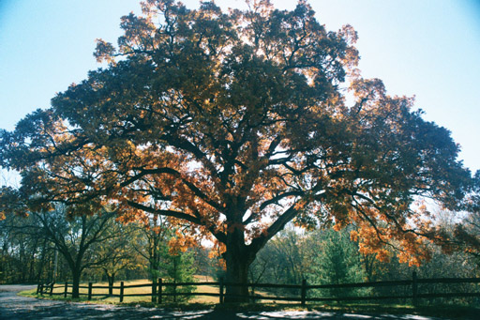
RGB Image
Color image or RGB image:
each pixel contains a vector
representing red, green and
blue components.
RGB components

Slide 11
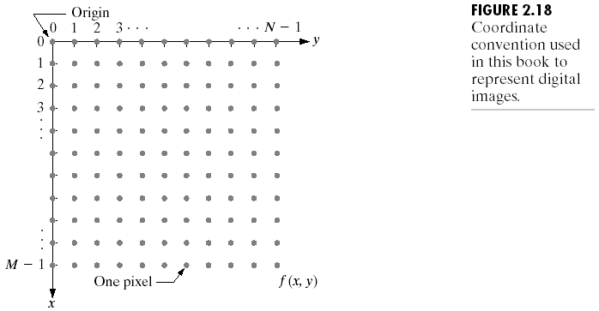
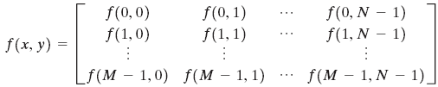
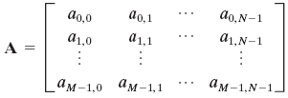
Representing Digital Images

Slide 12
Representing Digital Images
The pixel intensity levels (gray scale levels) are in the
interval of [0, L-1].
0 ≤ a_{i,j} ≤ L-1 Where L = 2^{k}
The dynamic range of an image is the range of values spanned by the gray scale.
The number, b, of bits required to store a digitized image of size M by N is
b = M × N × k

Slide 13
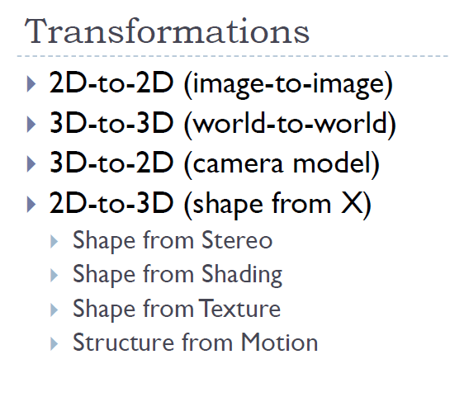

Slide 14
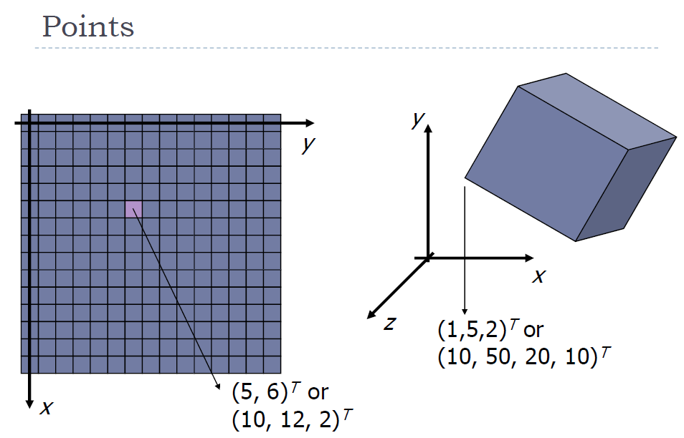

Slide 15
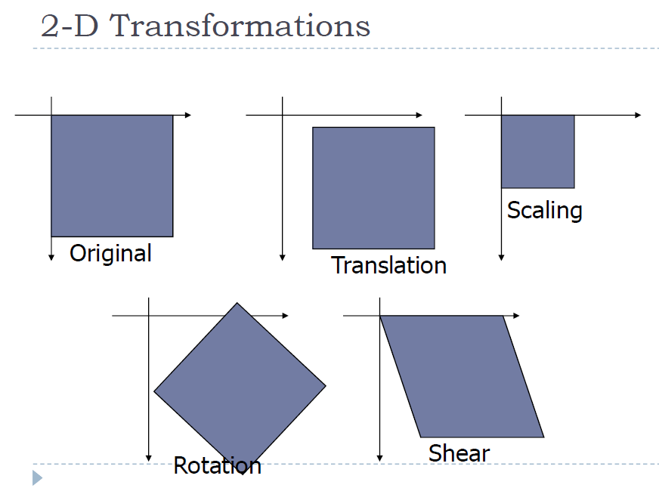

Slide 16
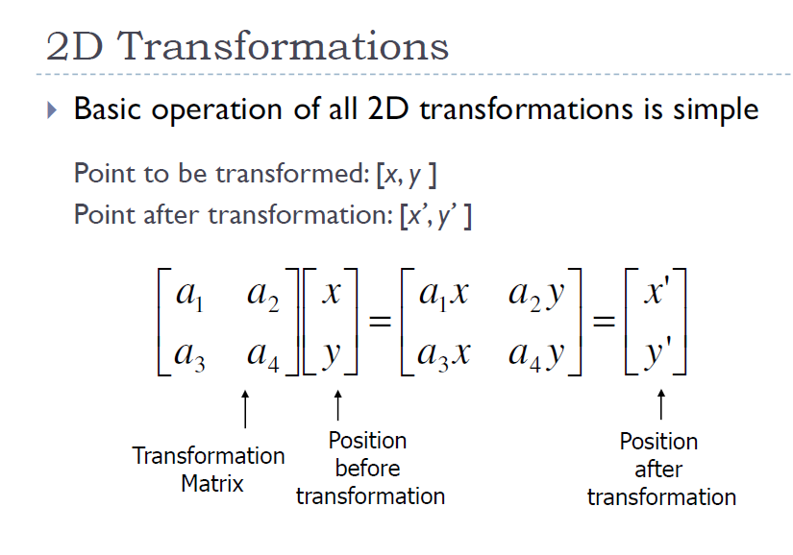

Slide 17
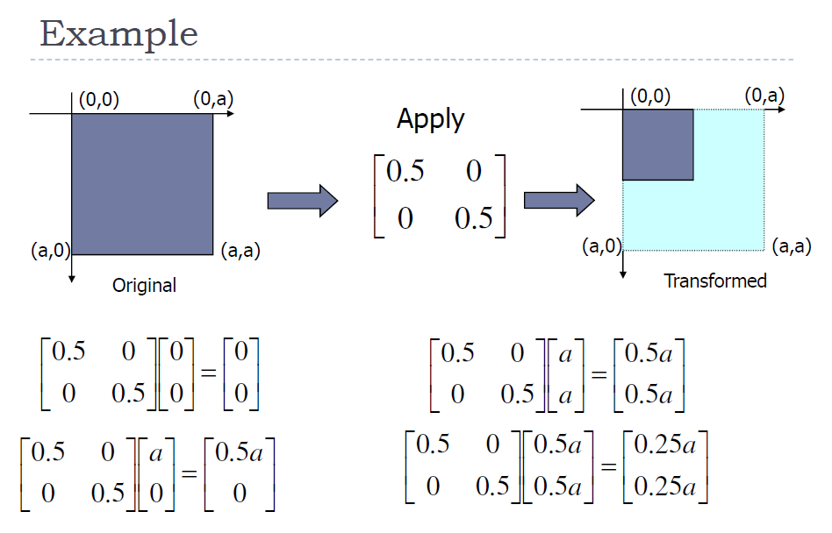

Slide 18
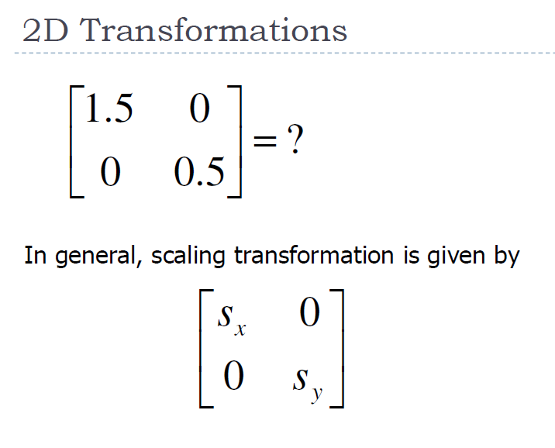

Slide 19
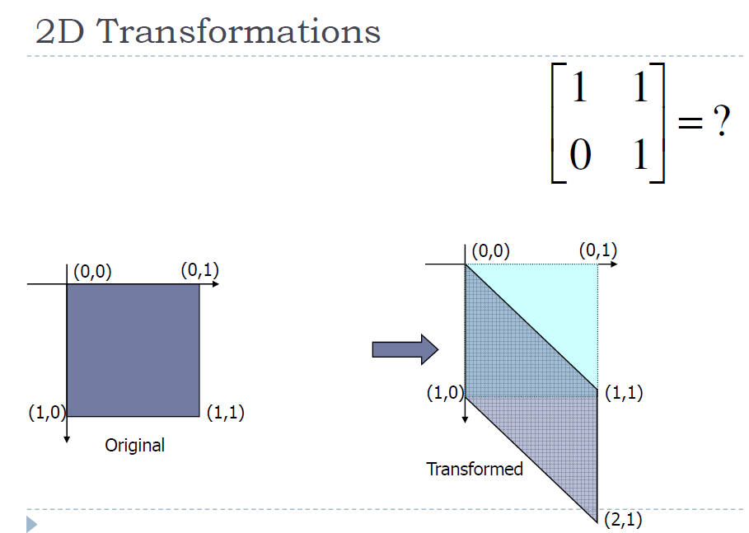

Slide 20
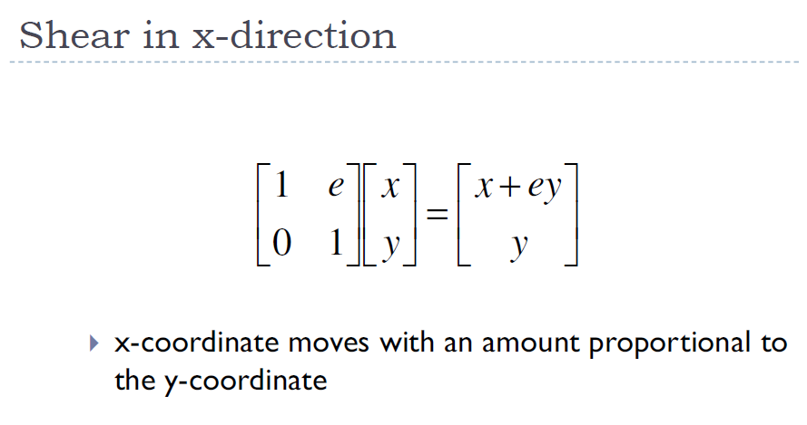
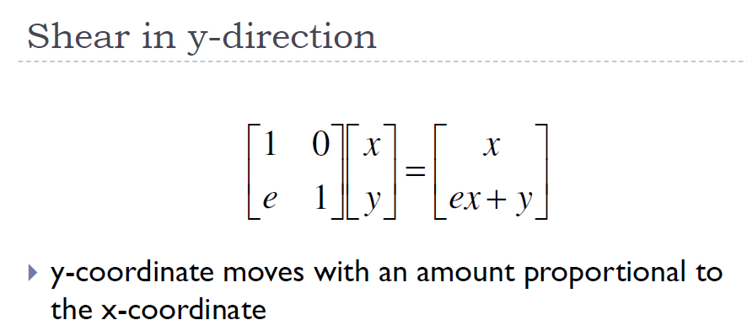

Slide 21
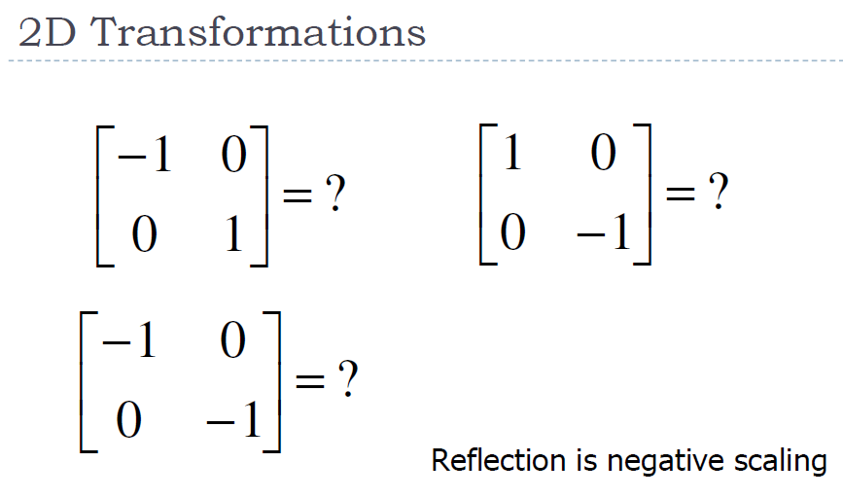

Slide 22
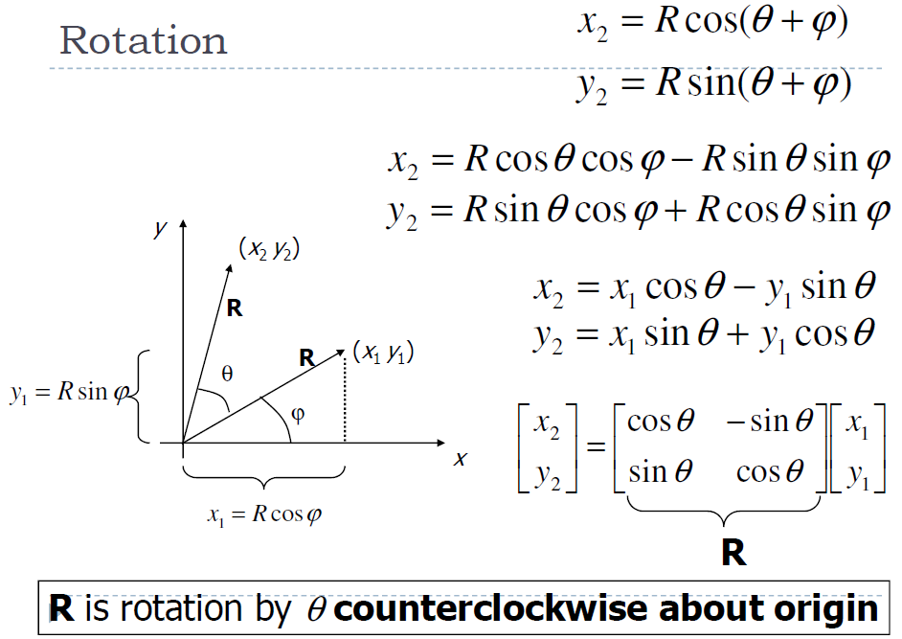

Slide 23
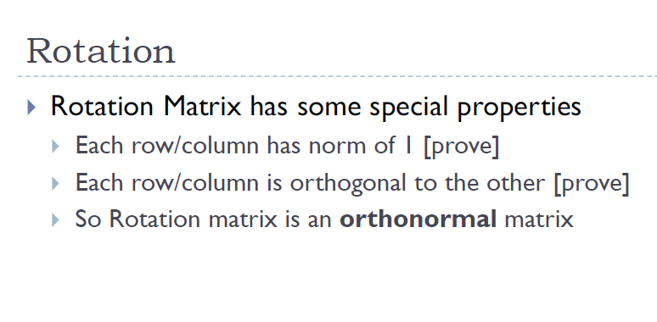

Slide 24
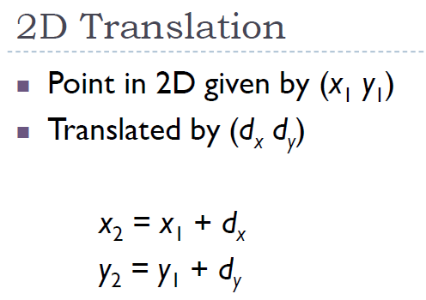

Slide 25
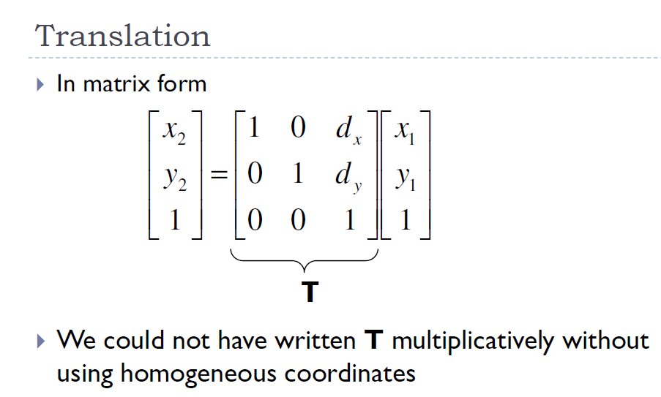

Slide 26
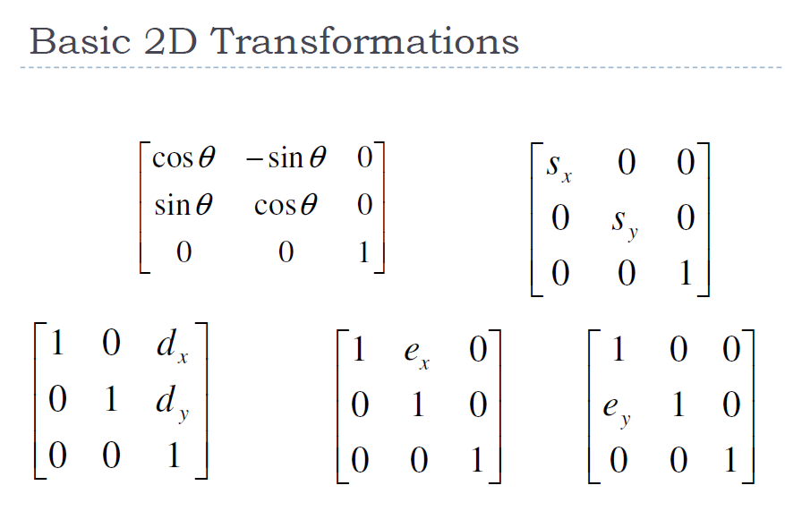

Slide 27
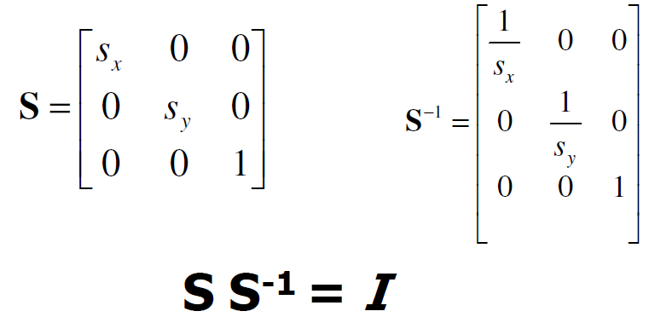
Inverse Transforms

Slide 28
Inverse Transforms
What is Inverse of Rotation?
What is inverse of Translation?
What is inverse of Shear in X-direction?
What is inverse of Shear in Y-direciton?

Slide 30
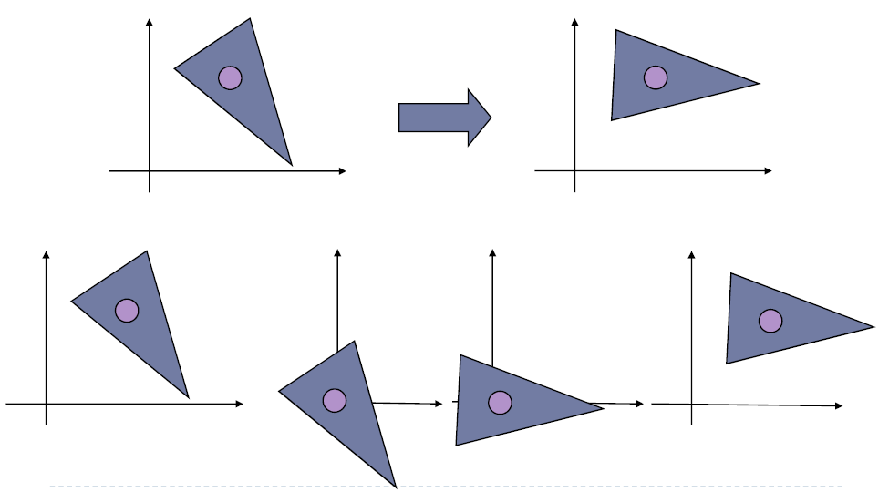

Slide 31
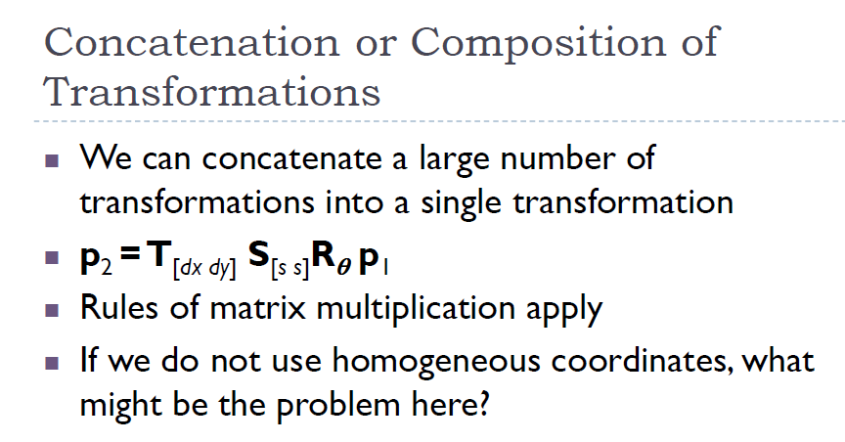

Slide 32
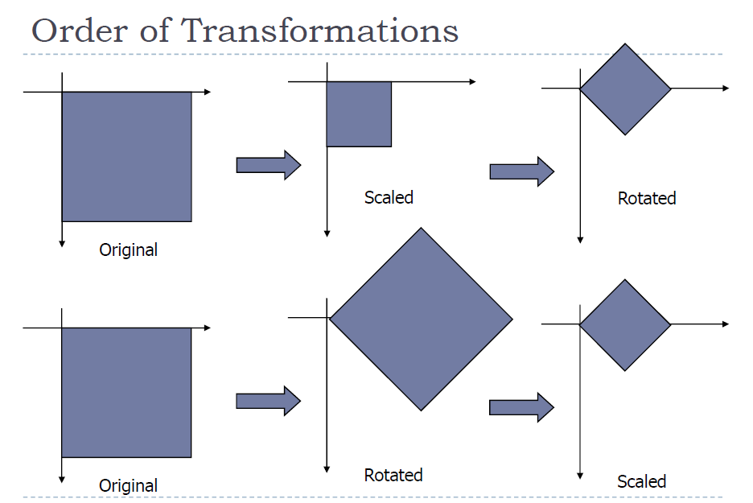

Slide 33
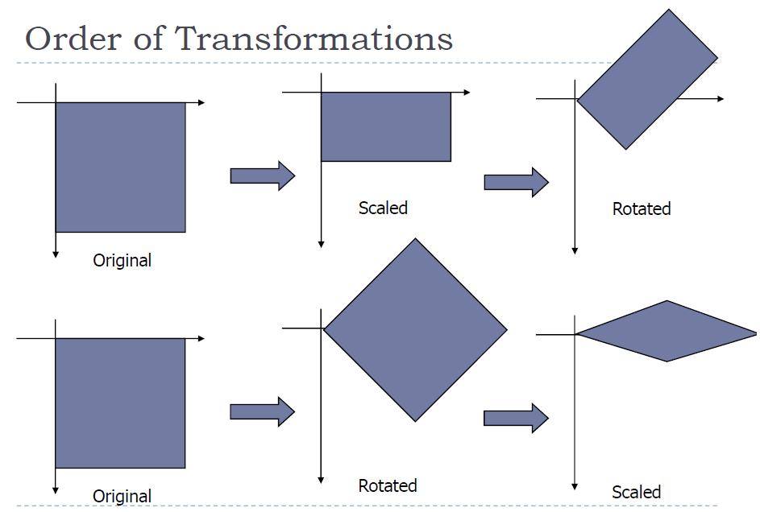

Slide 34
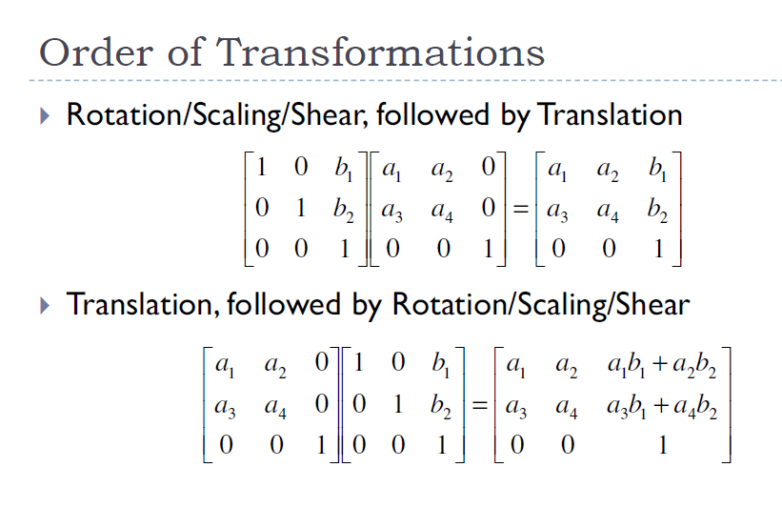

Slide 35
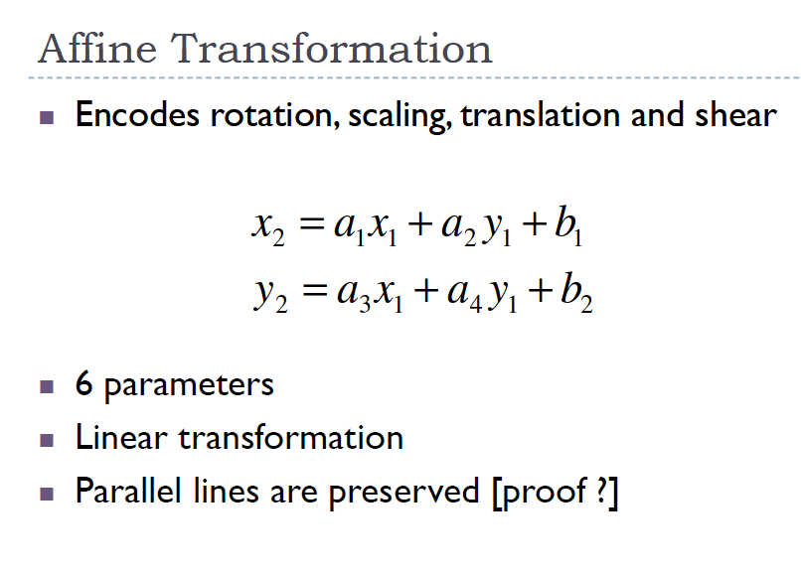

Slide 36
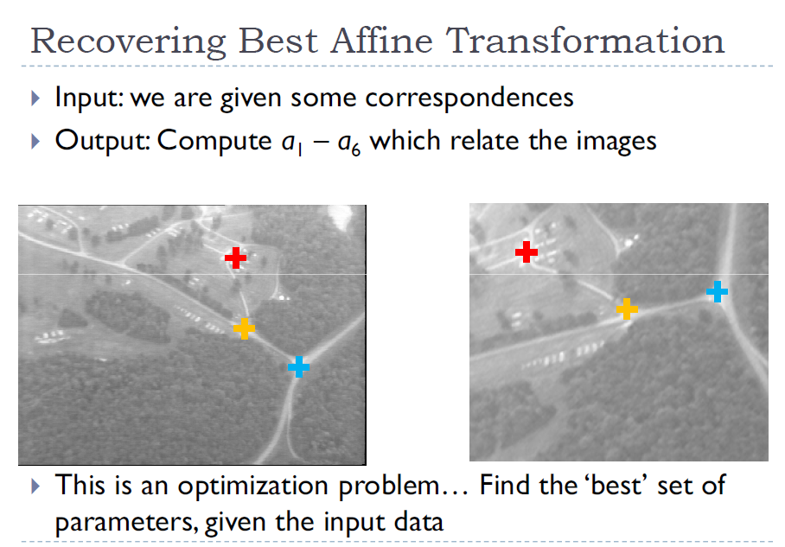

Slide 37
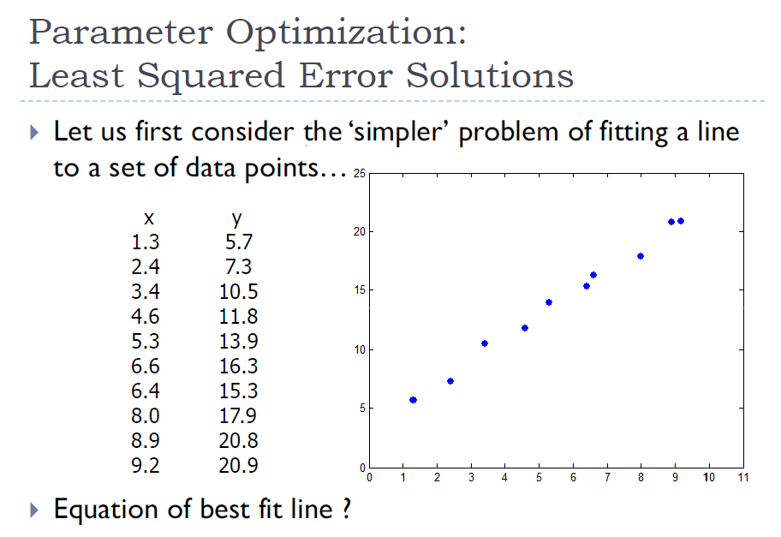

Slide 38
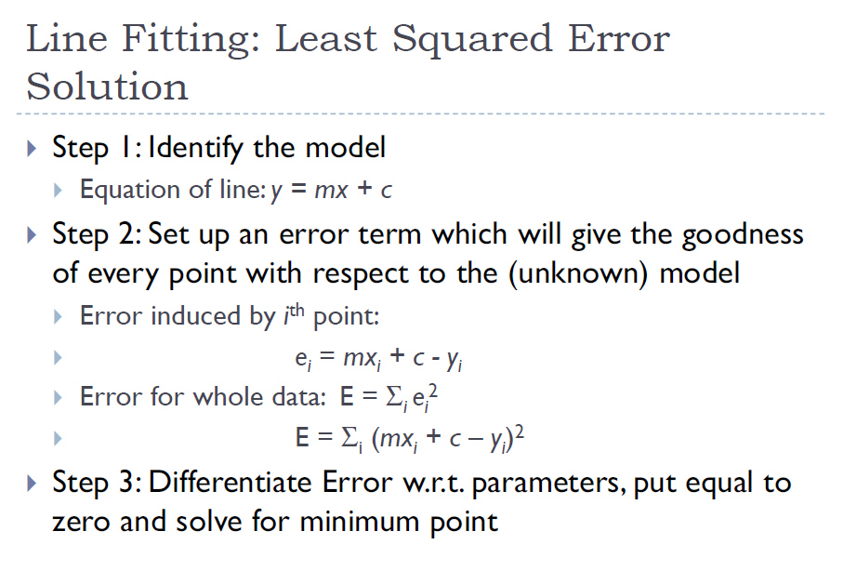

Slide 39
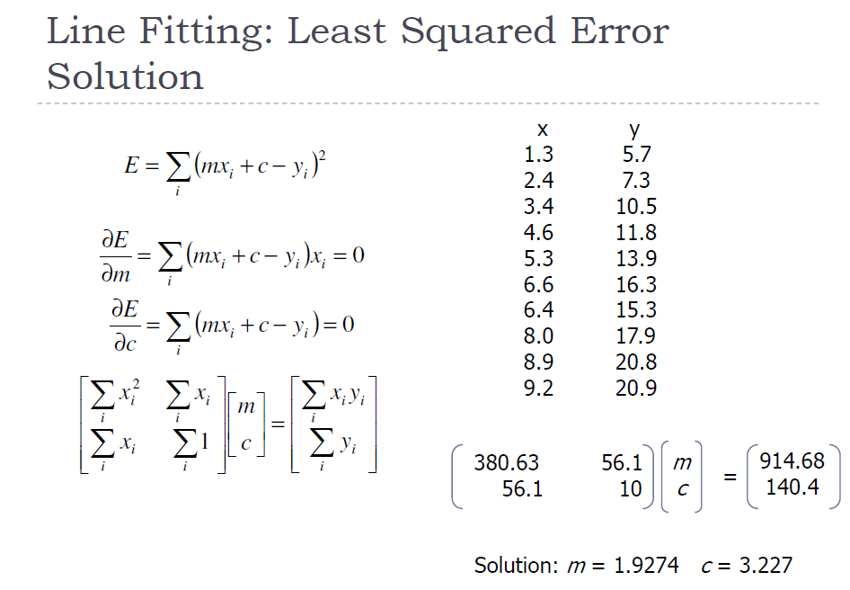

Slide 40
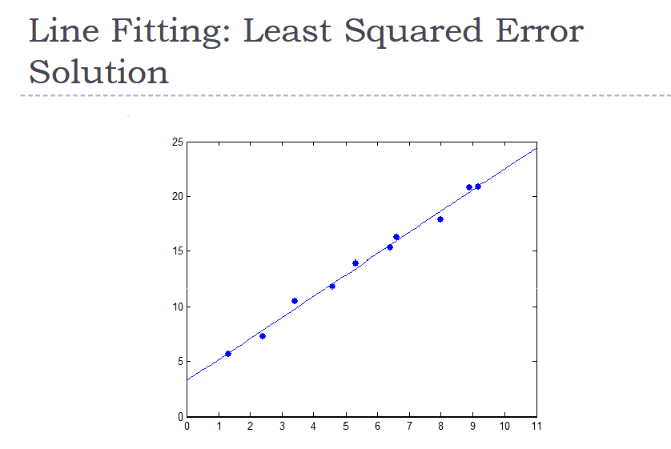

Slide 41
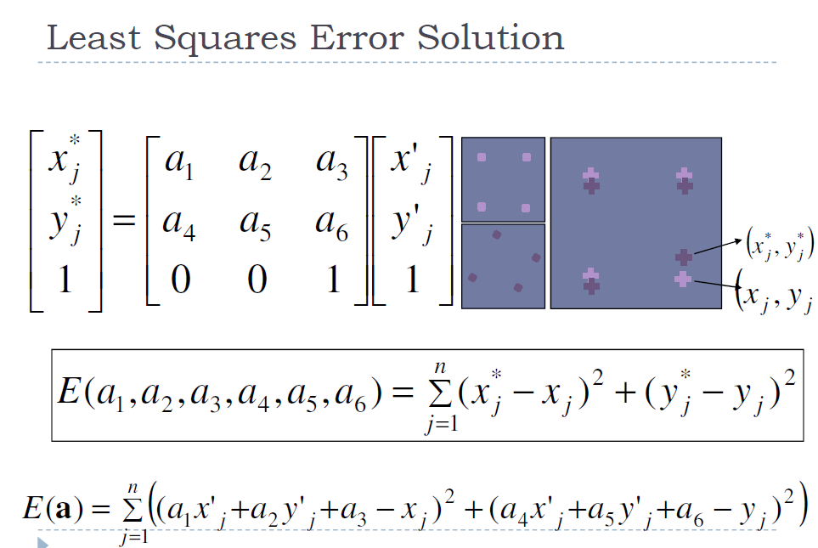

Slide 42
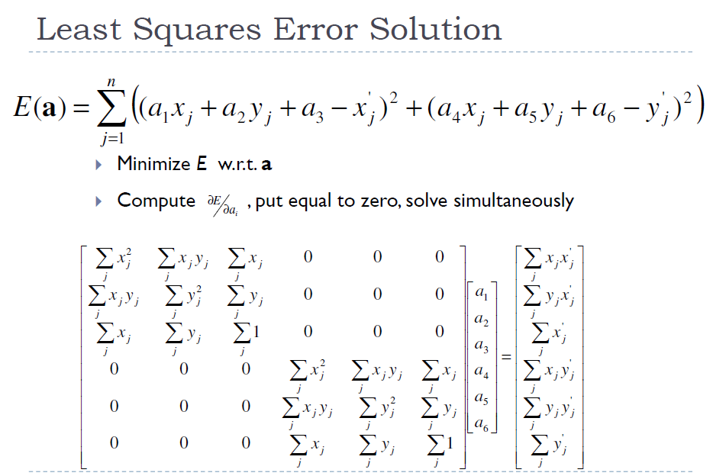

Slide 43
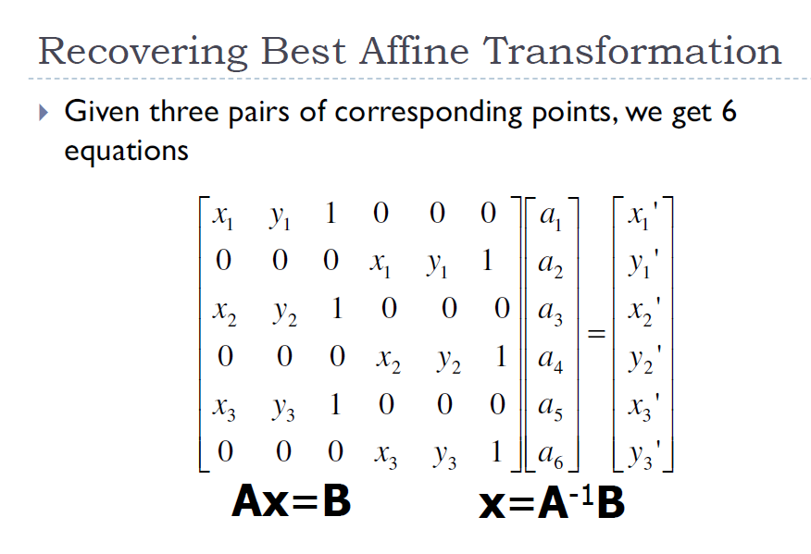

Slide 44
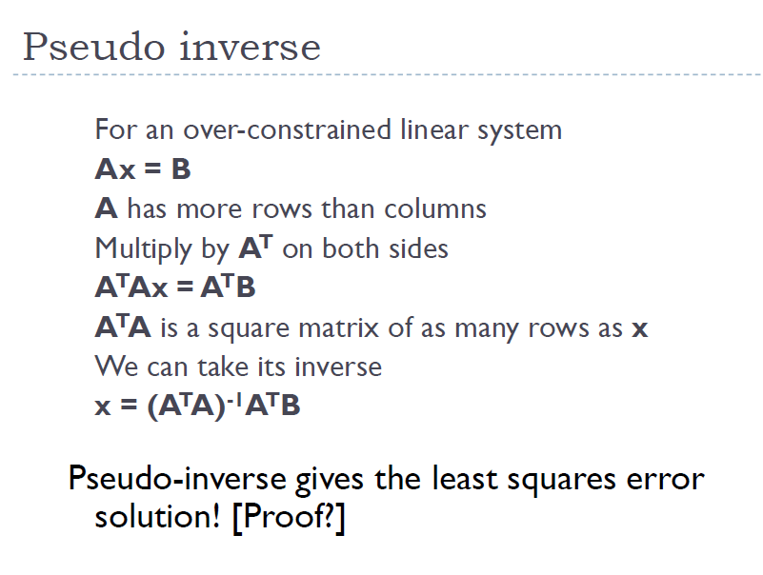

Slide 45
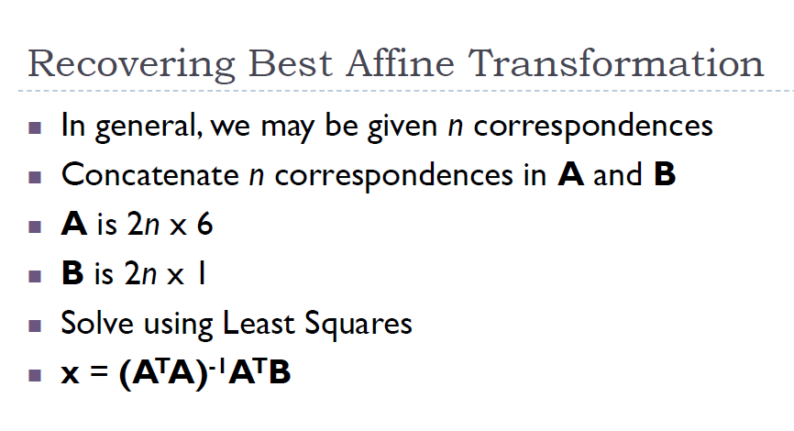

Slide 46
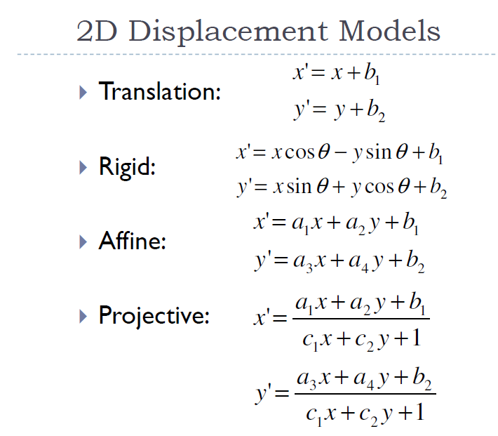

Slide 47
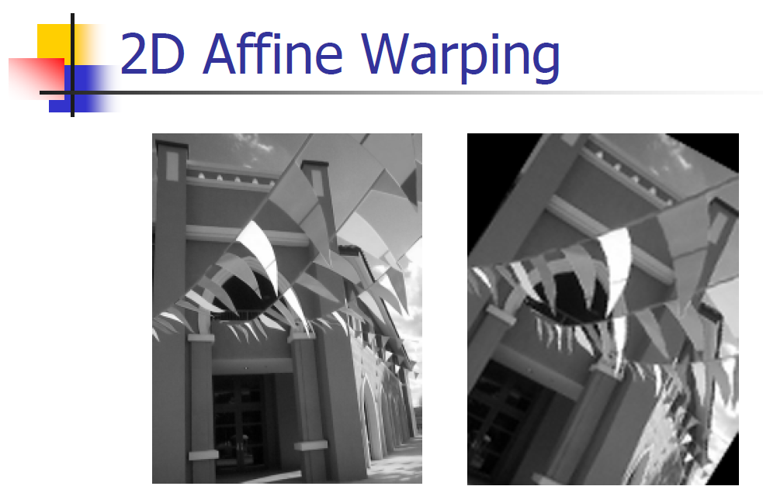

Slide 48
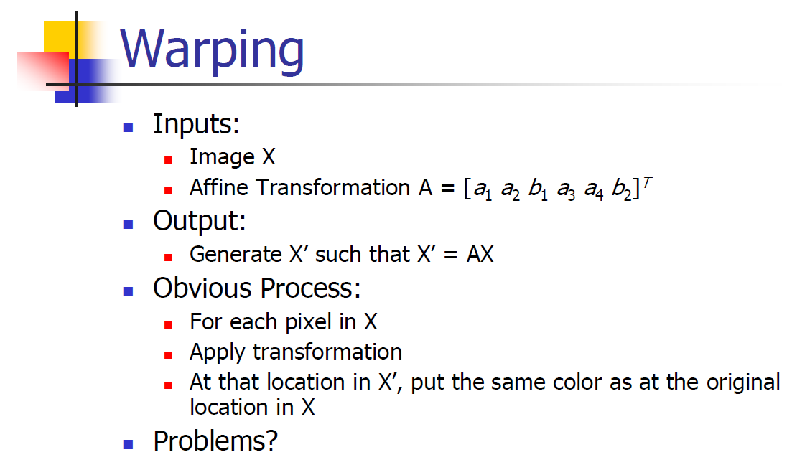

Slide 49
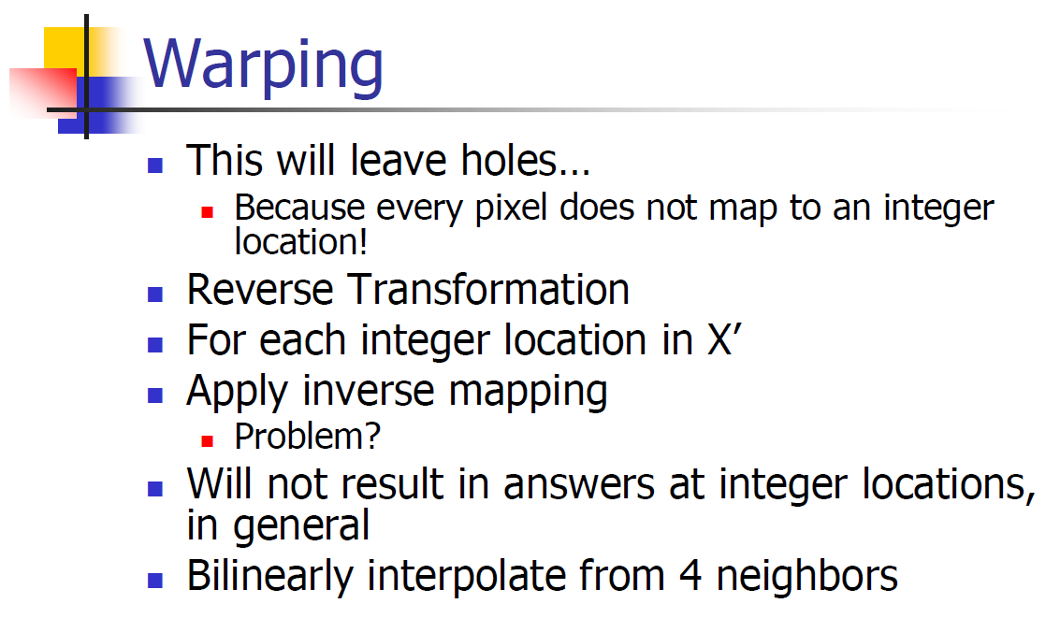

Slide 50


Slide 51


Slide 52
2-D Projective Transform
Also Called 2-D Homography
Dof?
Invariants? Lines map to lines!
Linear Transform?

Slide 53



Estimation of Homography: DLT
Direct Linear Transform (4.1 MVG Hartly & Zisserman)

Slide 54



Estimation of Homography: DLT
Direct Linear Transform (4.1 MVG Hartly & Zisserman)

Slide 55

Estimation of Homography: DLT
Direct Linear Transform (4.1 MVG Hartly & Zisserman)

Slide 56


Estimation of Homography: DLT
Direct Linear Transform (4.1 MVG Hartly & Zisserman)

Slide 57


Estimation of Homography: DLT
Direct Linear Transform (4.1 MVG Hartly & Zisserman)

Slide 58
Estimation of Homography: DLT
Direct Linear Transform (4.1 MVG Hartly & Zisserman)
How many correspondences?
A is rank deficient!
Null Space of A
Invertibilty of H?
Over determined system in the existence of noisy markings?

Slide 59
Projective Warping
See : Home Work 1

